Slide 1

Used Car Prediction
Speakers
Carolina Rojas, Gabrielle Morgan, Zoe Shields

Slide 2
Objectives
Problem at hand:
We will be executing three different types of machine learning models in order to observe which model performs better when predicting future used car prices from a specific dataset.
The three models we will be testing are random forest, XG boost, and Multi linear regression models

Slide 3

Table Of Content
About Our Project
Data Processing
01
04
What are we predicting and the models we are testing
Checking for missing values, changing data from categorical to numerical
About our models
Training and Evaluating Models
02
05
Explaining random forest, XG boost, and multi linear models
Process of training random forest, XG boost, and multi linear models
Describing the Data Set
Final model
03
06
Checking for missing values, changing data from categorical to numerical
Based on accuracy, the best model for Used Car Price Prediction

Slide 4
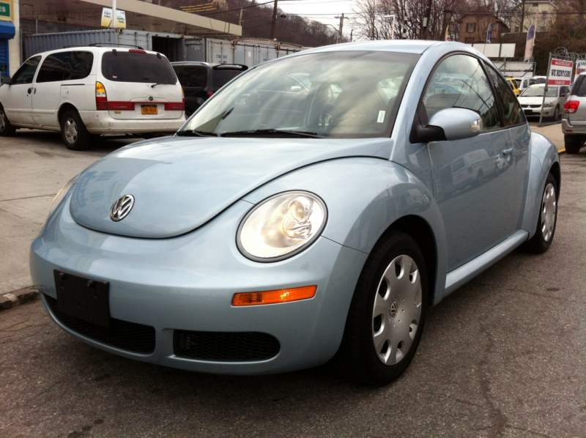
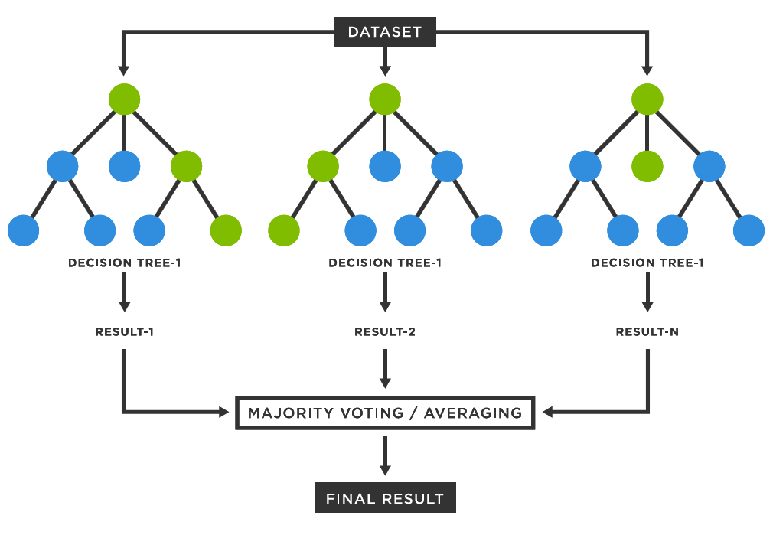
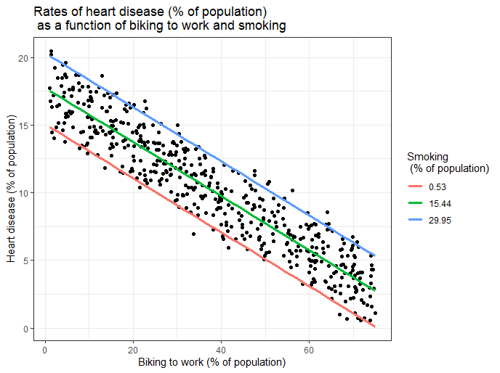
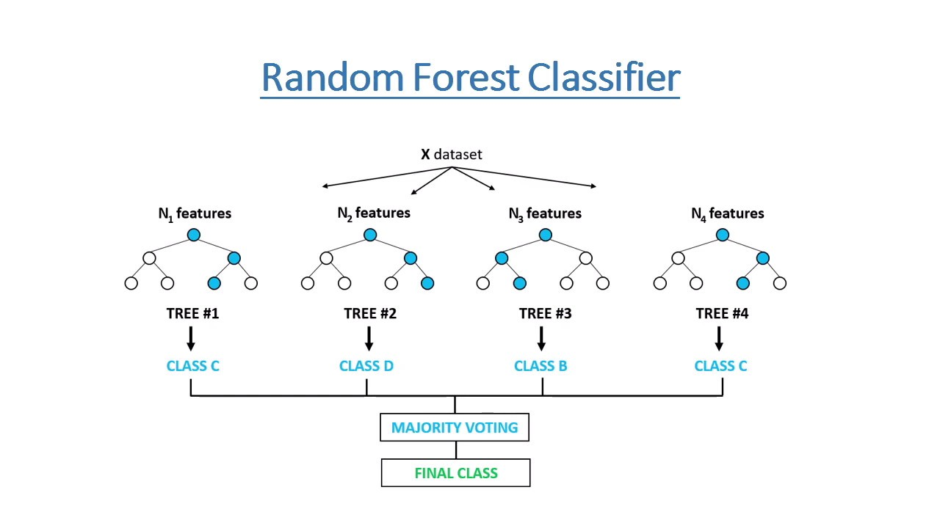

About our Project
Our goal is to create and find the most optimal model for Used Car Price Prediction. The three models we're testing are:
XG
Boost
Multi-Linear Regression
Random
Forest

Slide 5
About our Models

Slide 6



XG Boost
XG Boost stands for Extreme Gradient Boosting, and is a decision tree-based algorithm. It is mostly implemented when performing regression, classification, and ranking. XG Boost builds a predictive model by combining the predictions of multiple individual models, such as decision trees.
Gabrielle Morgan
1st Speaker
How It Works: weak learners are sequentially added to the ensemble, with each new one correcting the errors of the existing ones. It uses a gradient descent optimization technique to minimize a predefined loss function during training.

Slide 7
Multi-Linear Regression
A statistical technique that predicts outcomes based on multiple factors . Multiple regression is an extension of linear (OLS) regression which uses just one explanatory variable.
Example: Agricultural scientists often use linear regression to measure the effect of fertilizer and water on crop yields.
For example, scientists might use different amounts of fertilizer and water on different fields and see how it affects crop yield. They might fit a multiple linear regression model using fertilizer and water as the predictor variables and crop yield as the response variable. The regression model would take the following form:
crop yield = β₀ + β₁(amount of fertilizer) + β₂(amount of water)
Carolina Rojas
2nd Speaker
Crop yield represents the output or result we're trying to predict
β0​ is the intercept term, which represents the value of the crop yield when both the amount of fertilizer and water are zero.
β1​ is the coefficient for the amount of fertilizer. It tells us how much the crop yield is expected to increase (or decrease if negative) for each unit increase in the amount of fertilizer used, assuming all other factors remain constant.
β2​ is the coefficient for the amount of water. It tells us how much the crop yield is expected to increase (or decrease if negative) for each unit increase in the amount of water applied, assuming all other factors remain constant.

Slide 8
Random Forest
Random forest algorithm is the use of multiple decision trees to reach a single result. It specifically handle continuous data (regression) and categorical variables (classification)
Example of a random forest model would be picking out a car to buy. It will take multiple cars that you are looking at and based off the data of what you are looking for specifically (color, model, year, price) it will go through and predict which car is best to your liking.
Zoe Shields
3rd Speaker

Slide 9
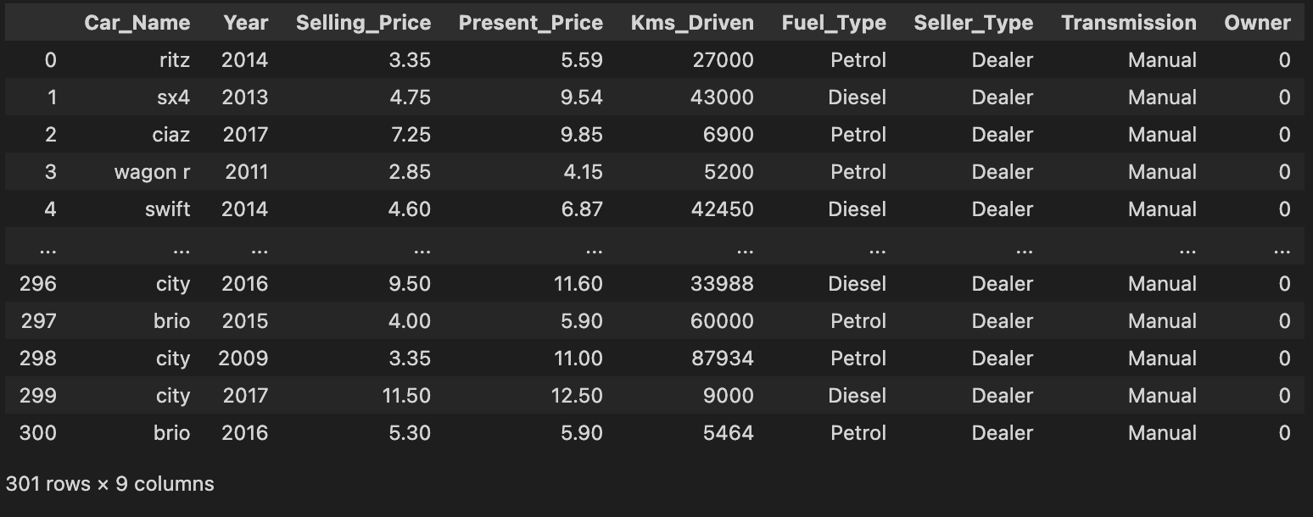
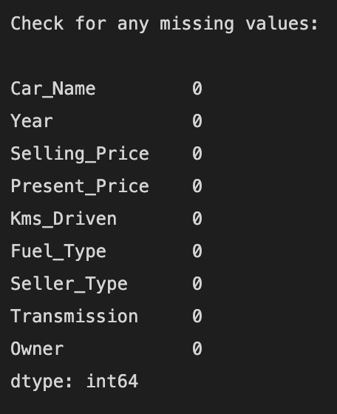
Describing the Data Set
Our data set, "car_data.csv" consists of 301 rows and 9 columns. The attribute names (columns) are:
Car Name
Year
Selling_Price
Present_Price
Kms_Driven
Fuel_Type
Seller_Type
Transmission
Owner
Every row is a record, based on a used car.
The attributes Car Name, Fuel_Type, Seller_Type, and Transmission contain categorical data.
There are no missing values in the data.

Slide 10
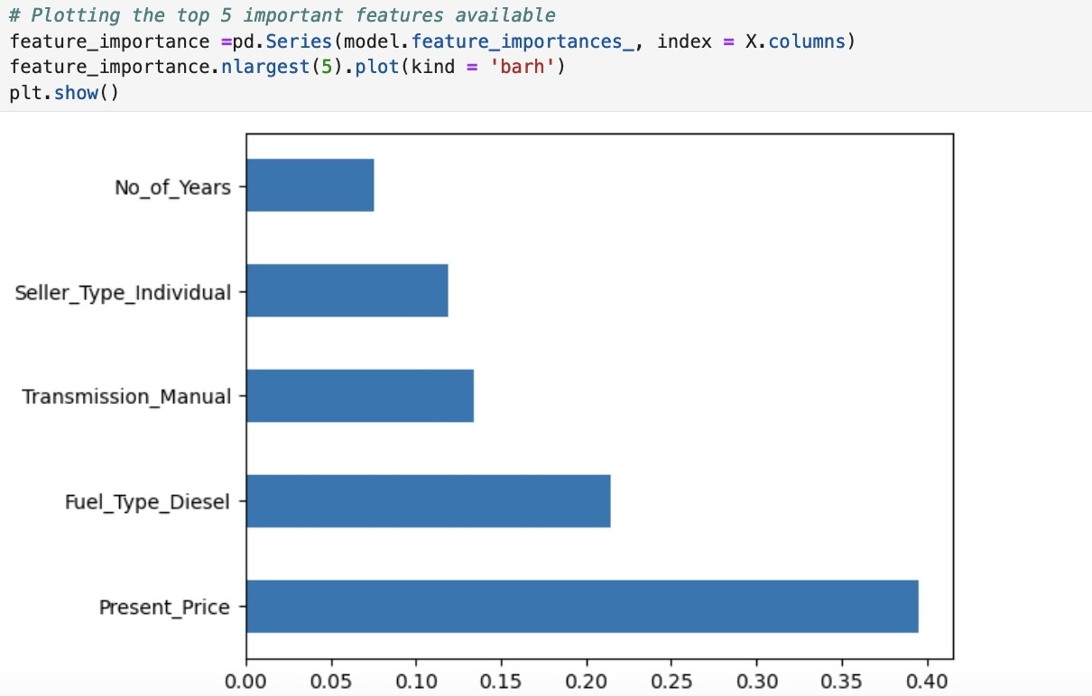
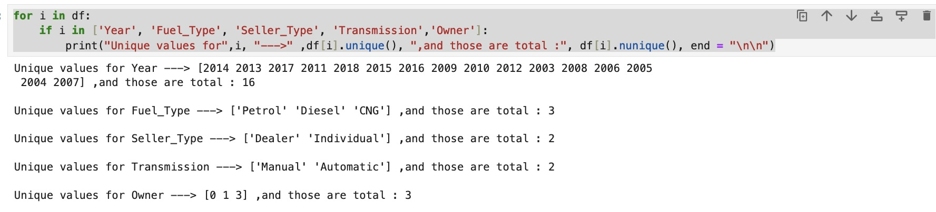
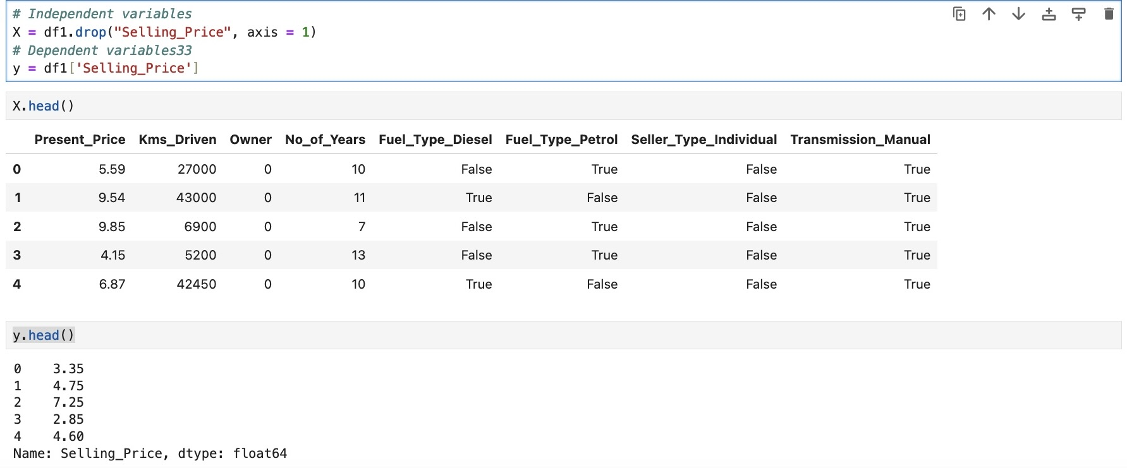
Data Pre-Processing
Before we began to process the data, we checked for important and unique features to determine if we had to drop any columns and also to see which columns would provide the most relevant information to predict our target variable. After this we selected or dependent and independent variables.

Slide 11
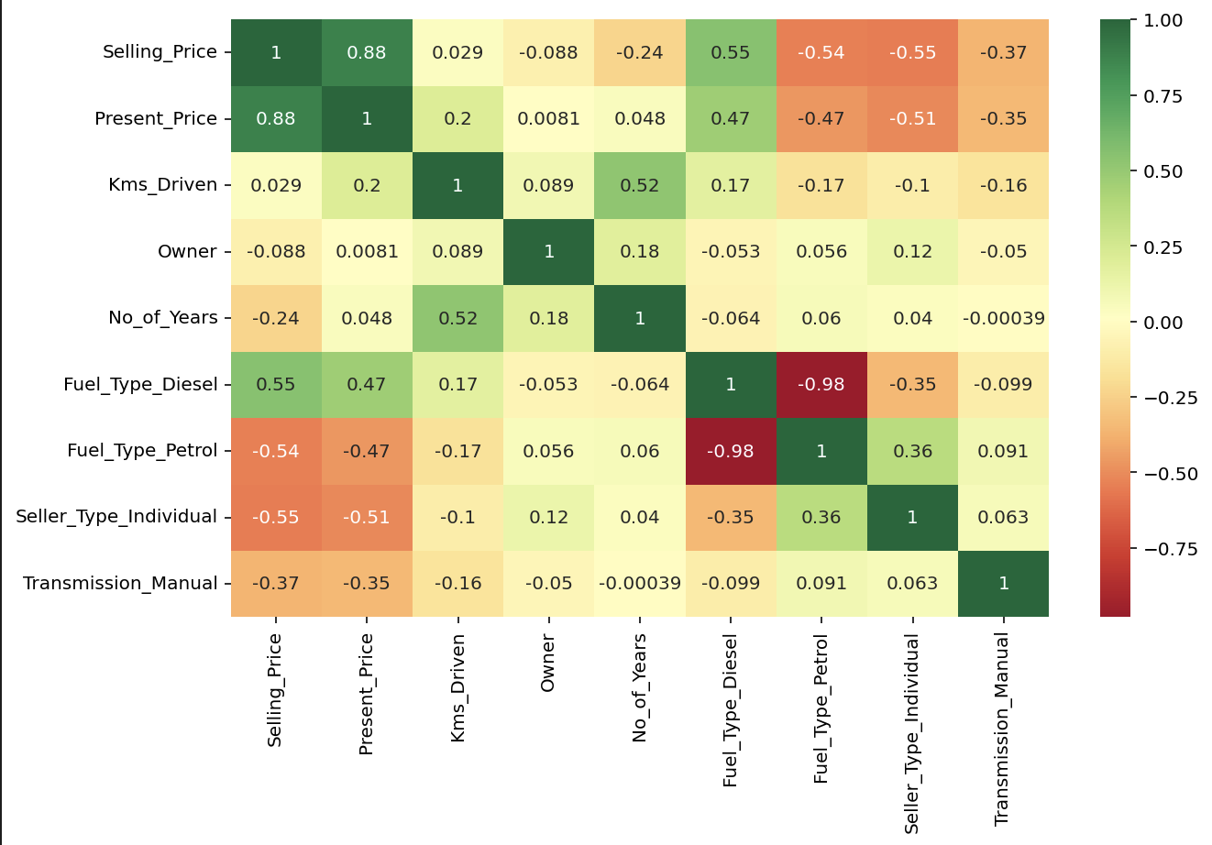
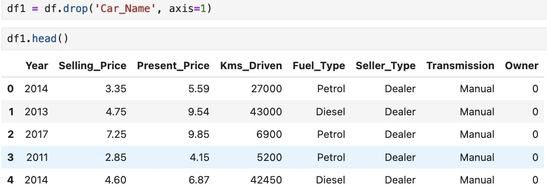
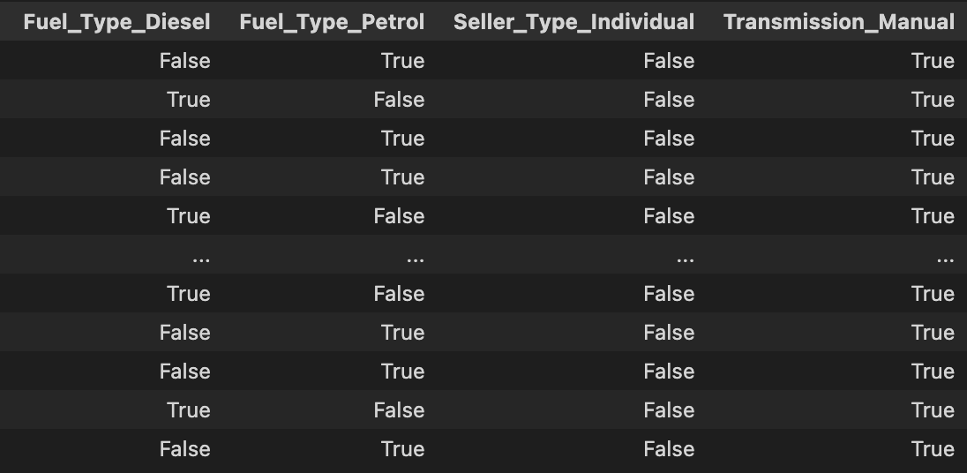
Data Pre-Processing
For data processing, we checked for missing values, removed attributes that didn't affect the prediction for easier processing, and created new attributes when turning the categorical values into numerical values.
We generated a correlation map to understand how one attribute affects another. For example, Selling price and Diesel fuel type have a strong correlation meaning that the car’s fuel type can affect the selling price. Whether the car is being sold by a dealer or an individual has little effect to the selling price

Slide 12
Training and Evaluating Models
Before we began to split the data, we checked for important and unique features to determine if we had to drop any columns and also to see which columns would provide the most significant information. After this we dropped the Selling_Price column and made it our Dependent (target) variable.

Slide 13
Thank You! Questions?

